Slide 1
Video Game Sales Prediction
By Deion Nwaefulu

Slide 2
The Problem
Video games have been developed throughout the years by companies and publishers like Nintendo, Sega, Electronic Arts (EA), and Sony. However, while there are many well known characters and series, certain games have disappeared from the sales market due to the following:
Innovation in systems and graphics (PS5, Switch, and Xbox One X or S)
Content the game provides (Story and mechanics)
Popularity (How well known it is)
Exclusivity (Made for only that system)
How can I tell which game will still be popular and around in the sales market?

Slide 3
Effect of Sales Decrease
When a new system with improved capabilities releases, the games released during a previous systems lifespan are either remastered or left untouched. This leads to video games highly rated by players to be:
Rare to find
More expensive today then it’s release

Slide 4
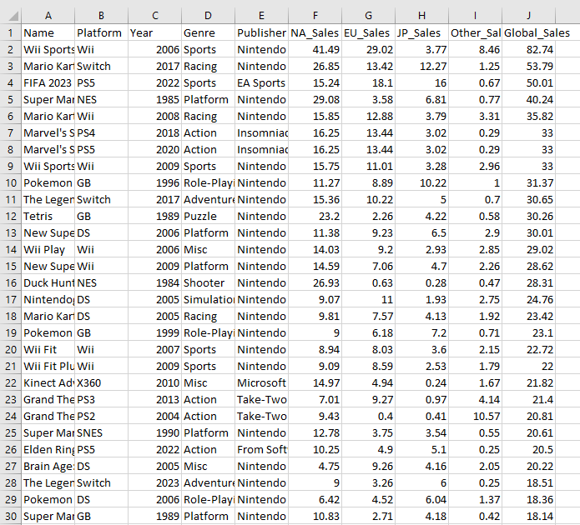
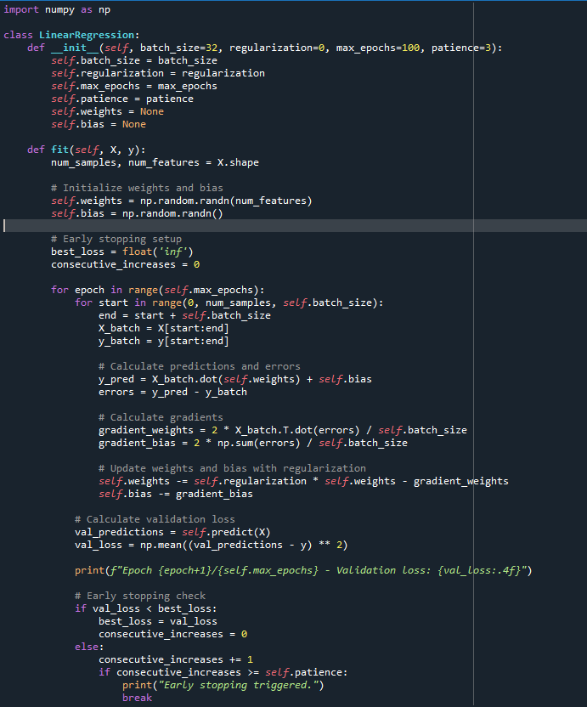
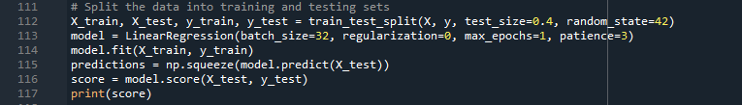
Video Game Prediction (Linear Regression)
Using the Linear Regression method, the machine learning algorithm takes the data from the ‘vgsales.csv’ file and provides a predicted forecast of the global sales of a video game based on the platform and genre of each game.

Slide 5





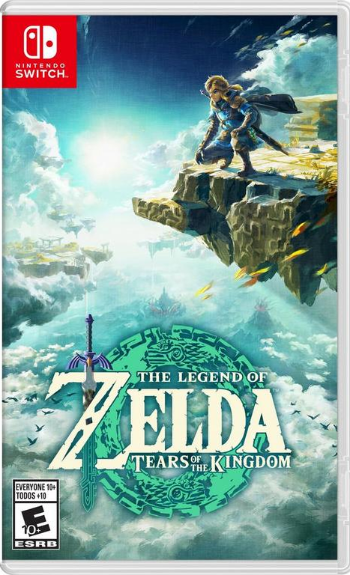

Sales factor
Console Exclusive
Games that can only be played for a specific console
Multi-Platform
Games that can be played on multiple platforms
All-in-One
Games that contain more than one title.

Slide 6
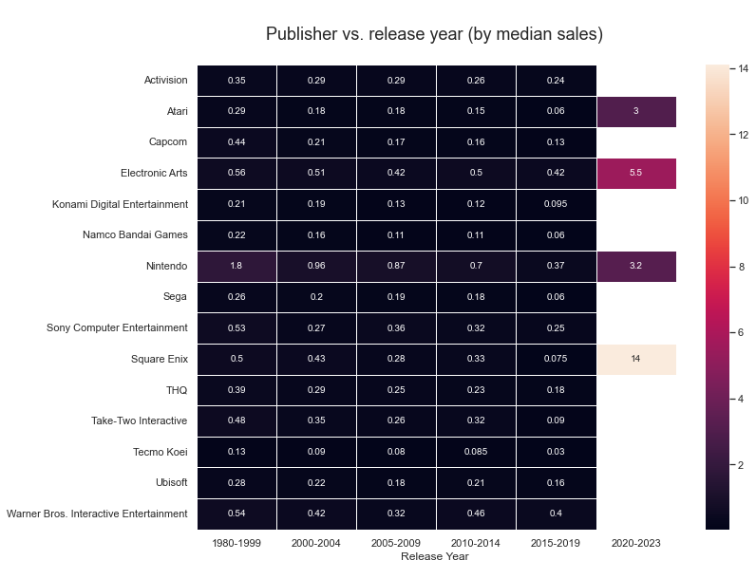
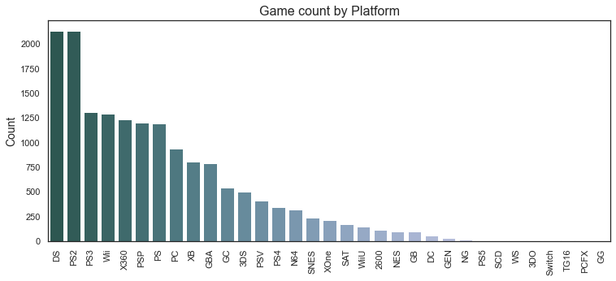
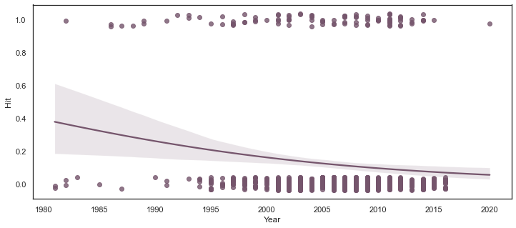
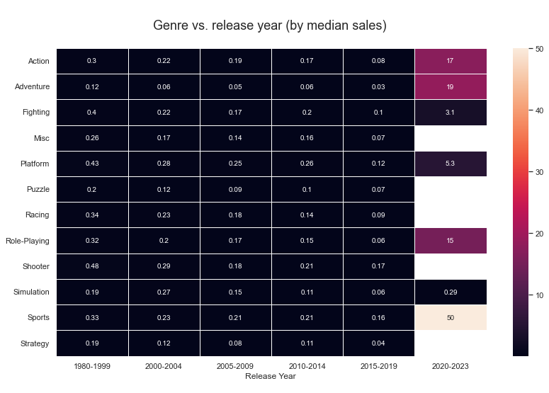
Bar Plot of games per console
Heatmap of publishers by year
Heatmap of genres by year
Plot of games hits that sold over a million copies

Slide 7
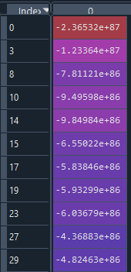
Results
Name | Platform | Year | Genre | Publisher | Global Sales | Predicted sales
Wii Sports | Wii | 2006 | Sports | Nintendo | 82.74 | 80.38
Super Mario Bros. | NES | 1985 | Platform | Nintendo | 40.24 | 39.01
Pokemon Red/Pokemon Blue | GB | 1996 | Role-Playing | Nintendo | 31.37 | 23.56
Tetris | GB | 1989 | Puzzle | Nintendo | 30.26 | 20.77
Duck Hunt | NES | 1984 | Shooter | Nintendo | 28.31 | 18.46
Nintendogs | DS | 2005 | Simulation | Nintendo | 24.76 | 18.21
Pokemon Gold/Pokemon Silver | GB | 1999 | Role-Playing | Nintendo | 23.1 | 17.27
Wii Fit Plus | Wii | 2009 | Sports | Nintendo | 22 | 16.07
Super Mario World | SNES | 1990 | Platform | Nintendo | 20.61 | 14.58
Pokemon Diamond/Pokemon Pearl | DS | 2006 | Role-Playing | Nintendo | 18.36 | 13.99
Super Mario Bros. 3 | NES | 1988 | Platform | Nintendo | 17.28 | 12.46
Score: 2.82

Slide 8
Conclusion
In conclusion, money is printed everyday for every year, but games developed depend on how popular they are or if accessibility is possible. (Ex: Nintendo Eshop for 3DS and Wii U shutdown)
With this sales prediction algorithm you can:
Stay current with the sales
Determine whether the game is worth trying
Decide whether it’s worth keeping

Slide 9
REsources
https://corgis-edu.github.io/corgis/csv/video_games/
https://www.statista.com/
https://www.kaggle.com/code/ignacioch/predicting-vg-hits-1-million-sales-with-lr-rfc?scriptVersionId=0
www.gamestop.com/
https://thecleverprogrammer.com/2021/05/28/video-game-sales-prediction-model-with-python/

